Slide 1
Seminar Presentataion on Regulation of Gene Expression in Prokaryotes and Eukaryotes
SUBMITTED TO DEPARTMENT OF BOTANY
GOVT. DIGVIJAY AUTONOMOUS P.G. COLLEGE RAJNANGAON (C.G.)
GUIDED BY :- PRESENTED BY :-
Dr. Hemlata Virdi Durgesh Nandini Padauti
(M.Sc. Pre.)
Botany

Slide 2
-: Regulation of Gene Expression in Prokaryotes and Eukaryotes :-
Content :-
Introduction
Definition
History
Gene Regulation
Regulation of Gene expression in Prokaryotic cells
Regulation of Enzyme
Lac Operon
Structure of Lac Operon
Mechanism or Action of Lac Operon
Regulation of Gene Expression in Eukaryotes
Structure of Gene battery and Tata box and Caat box
Conclusion
Reference.

Slide 3
Introduction :-
A gene is a small part of a large molecule called DNA that handles the formation of proteins.
The gene is found above the chromosome inside the nucleus. Genetic characters are transfer from one generation to another.
this are called as unit of genetics.

Slide 4
Definition :-
Genes are the unit of transmission of characters from generation to generation.
Genes are the unit of genetics.
In general one gene is responsible for the expression of one character in on organism.

Slide 5
History :-
The History gene was first proposed by Johansen in 1905.
Watson and Crick (1953) explained that Genes are micro molecules that are made of C, H, O, N, P.

Slide 6
Gene Regulation :-
Gene is a functional unit of living organism.
Thousands of genes are found in each cell in the gene, but not all genes are active simultaneously.
Genes that are modifiable when needed at a specific time called switched on gene and those who are inactive called switched off genes.
The formation of proteins is called gene regulation.

Slide 7
Regulation of Gene expression in Prokaryotic cells :-
In the study of gene regulation was done in a bacteria called prokaryotic E. coli.
The gene regulation in E coli. and other prokaryotes occurs at 2 levels.
Regulation of Enzyme.
Regulation of transcription and translation.

Slide 8
Regulation of Enzyme :-
According to JACOB and MONAD (1961), the synthesis of enzyme related to the metabolism of lactose sugars takes place by the following process.
Induction
Repression
Feed back inhibition.
Regulation of Transcription and Translation

Slide 9
Lac Operon :-
Jacob and Monad (1961) presented the operon model for the regulation of gene function by studying lactose operon.
A group of structural and controlling genes that have genetic control over metabolism in the cytoplasm is called operon.
Structure of Lac Operon :-
According to Jacob Monad, lactose operon is made up of 2 genes.
Operon
Structural Genes
Controller Genes
Regulator Genes
Cistron Z
Promoter Genes
Operator Genes
Cistron Y
Cistron A

Slide 10
Mechanism or Action of Lac Operon :-
BECKWITH (1967), EPSTEIN (1968), MARTIN (1969) studied the mechanism of operon in E. Coli lac operon.
According to them, operon regulates gene function in the following two stages.
Inducible System
When inducer molecules absent in medium.
When inducer molecules present.
Repressible System

Slide 11
When inducer molecules absent in medium

Slide 12
when inducer molecules present in medium

Slide 13
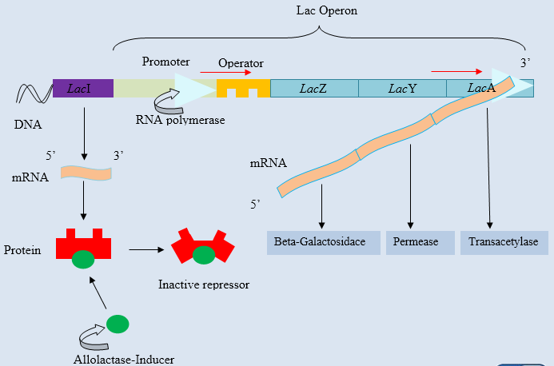
Lac operon model

Slide 14
Regulation of Gene Expression in Eukaryotes :-
R.J. Britten and E.H. Davidson (1969) presented as a popular model (Gene Battery Model) in These scientists used the word producer for structural genes.
The gene battery model consists of sequences of producer and integrator genes that participate in RNA transcription.
Sensors and receptors are site sequences that do not participate in the synthesis of RNA only to identify molecules.

Slide 15
Gene Battery Tata Box & Caat Box
The group of producer gene controlled by the sensor site is called a battery, in which the process of transcription starts by the integrator gene.
Goldberg and Hogness discovered this sequence in the 1980
The gene in the DNA chain is found to contain a sequence of 30 nucleotide TATA sequences that are required for translation.
Sequences of 200 bases are found before and after Tata Box which control the transcription process.

Slide 16
Gene battery model of Britten and Davidson
Tata box and caat box

Slide 17
Conclusion :-
Lactose is absent in medium – switch off
Lactose is added to the medium – switch on.
The sequence of bases controls the action of transcription.
In RNA Synthesis, some molecule participate and some molecule perform the task of identifying. There by completing the action of transcription.

Slide 18
Reference :-
C.B. POWAR – Cell biology
addition “1970” Reprint – “1981”
Source of Net.

